Slide 1
Understanding the EPA Fuel Economy Label for Plug-in Vehicles
FuelEconomy.gov

Slide 2
Understanding the Fuel Economy Label for Plug-in Vehicles
This presentation describes the EPA fuel economy labels for
All-Electric Vehicles (EVs)
Plug-in Hybrids (PHEVs):
Series Plug-in Hybrid Vehicles (aka Extended Range Electric Vehicles)
Parallel (Blended) Plug-in Hybrid Vehicles
Photo: Oak Ridge National Laboratory (2011-P03692)
Photo: Oak Ridge National Laboratory (2011-P03692)

Slide 3
All-Electric Vehicles

Slide 4
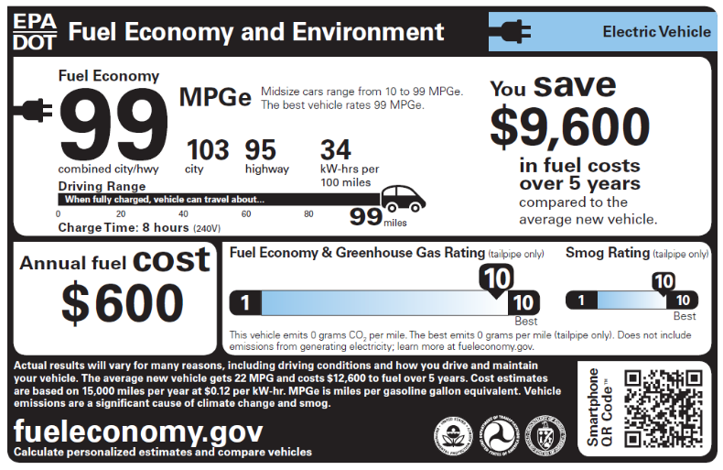
All-Electric Vehicle Fuel Economy and Environment Label
The fuel economy label of an all-electric vehicle will include the text “Electric Vehicle” in the upper right-hand corner
The label will also include a plug icon to identify it as a vehicle that is powered by electricity.

Slide 5
Fuel Economy Estimates for All-Electric Vehicles
City, highway, and combined MPGe values are displayed on the label.
The combined fuel economy estimate assumes you drive 55% of the miles in stop and go (city) traffic and 45% of the miles in free flowing (highway) traffic. Go to FuelEconomy.gov to customize values.
Fuel economy estimates for an all-electric vehicle are displayed as miles per gallon of gasoline-equivalent (MPGe).
To the right of the fuel economy estimates is text describing the best and worst fuel economy estimates for vehicles in that vehicle class (e.g., midsize cars, pickup trucks, etc.) for that model year.

Slide 6
Fuel Consumption Estimates for All-Electric Vehicles
The combined electricity consumption estimate assumes you drive 55% of the miles in stop and go (city) traffic and 45% of the miles in free flowing (highway) traffic.
The label also includes an estimate of the fuel efficiency of the vehicle in kilowatt-hours (kW-hrs) per 100 miles.
This value tells you how many kilowatt-hours the vehicle would use to travel 100 miles.
The fuel consumption metric allows you to compare electricity consumption between electric vehicles.

Slide 7
Driving Range for All-Electric Vehicles
The label for electric vehicles also includes an estimate of the driving range of the vehicle when fully charged.
This value represents the approximate number of miles that can be traveled in combined city and highway driving before the vehicle must be recharged.

Slide 8
Plug-in Hybrid Electric Vehicles

Slide 9
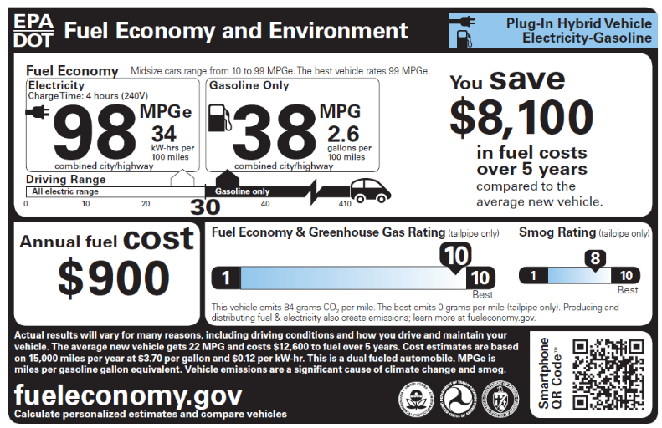
Plug-in Hybrid Electric Vehicle Fuel Economy and Environment Label
The fuel economy label for a Plug-in Hybrid Vehicle will include the text “Plug-in Hybrid Vehicle” and “Electricity-Gasoline” in the upper right-hand corner.
The label for a plug-in hybrid vehicle also includes a plug and a fuel pump icon to identify it as a vehicle that is powered by both electricity and gasoline.

Slide 10
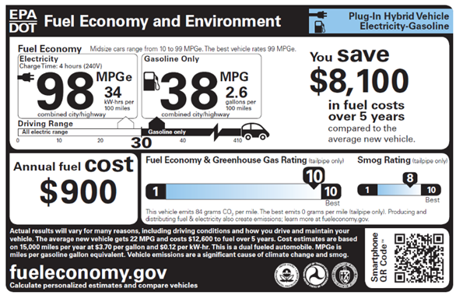
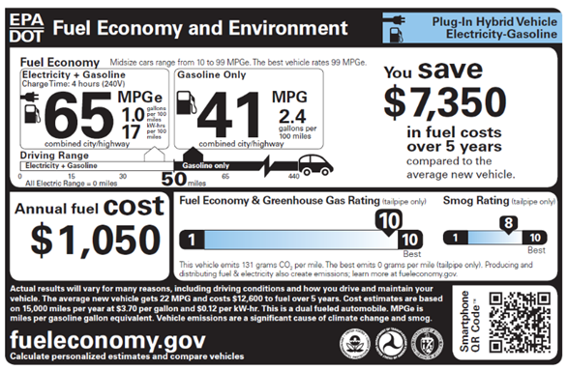
The fuel economy values for plug-in hybrid vehicles vary depending on whether the vehicle is a series or a parallel plug-in hybrid.
Series plug-in hybrid label
Parallel plug-in hybrid label

Slide 11
Series Plug-in Hybrid Electric Vehicles
The electric motor turns the wheels.
The gasoline engine is only used to generate electricity.
Series plug-ins can run solely on electricity until the battery needs to be recharged.
Some vehicles use the electric motor to drive the wheels most of the time, but the vehicle may operate as a parallel hybrid at highway speeds when the battery is depleted.
Vehicles that operate as a series parallel vehicle most of the time will also use the series plug-in hybrid fuel economy label.

Slide 12
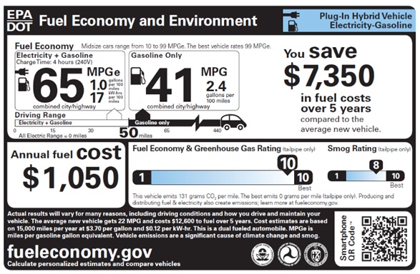
Parallel Plug-in Hybrid Electric Vehicles
In a parallel plug-in hybrid, both the engine and electric motor are mechanically connected to the wheels, and both propel the vehicle under most driving conditions.
Fuel economy and range are estimated for electricity and gasoline operation together.
There is no separate estimate for electric-only operation.

Slide 13
Series PHEV Fuel Economy Estimates
Two sets of fuel economy numbers are displayed:
The left-hand set of fuel economy numbers displays the fuel economy when operating on electricity alone.
The right-hand set of fuel economy numbers displays the fuel economy when the battery is depleted and the vehicle is using gasoline.
All these values represent the combined city-highway estimate.

Slide 14
Series PHEV Driving Range Estimates
The driving range is provided below the fuel economy estimates.
For a series PHEV, the driving range on electricity represents the approximate number of miles that can be traveled in combined city and highway driving on a single charge.
The total driving range represents the electricity range plus the distance the vehicle can travel on gasoline.

Slide 15
Parallel PHEV Fuel Economy Estimates
The label for a parallel plug-in hybrid electric vehicle displays two sets of fuel economy numbers.
The left-hand set of fuel economy numbers displays the fuel economy when operating on a mix of gasoline and electricity.
The right-hand set of fuel economy numbers displays the fuel economy when the battery is depleted and the vehicle is running on gasoline.
All these values represent the combined city and highway value.

Slide 16
Parallel PHEV Fuel Economy Range Estimates
The label for a parallel plug-in hybrid electric vehicle also displays the driving range on a mix of gasoline and electricity and the total driving range.
The label also displays the distance the vehicle can travel on electricity alone.

Slide 17
Charge Time for EVs and PHEVs
The charge time listed on the label indicates how long it takes to charge a fully empty battery.
For the purposes of equivalent comparisons, all electric vehicles display a charge time based on use of 240-volt service.
The actual time it takes to charge your vehicle will depend on the type of charger you use.

Slide 18
Annual Fuel Cost for EVs and PHEVs
The annual fuel cost shown on the fuel economy label is based on an annual mileage of 15,000 miles and projected fuel prices for the year.
Visit FuelEconomy.gov to personalize these fuel prices.
For PHEVs, a utility factor is used to estimate the share of miles the average driver will drive on electricity vs. gasoline.
FuelEconomy.gov’s “My Plug-in Hybrid Calculator” can help you estimate your annual fuel cost based on your driving habits.

Slide 19
Five-Year Fuel Costs or Savings
The label shows the estimated fuel cost over a five-year period for the vehicle compared to the average new vehicle of the same model year.
These five-year estimates are also based on 15,000 miles per year and projected fuel prices for the current year
The average MPG and cost to fuel an average vehicle for 5 years is shown in the fine print.

Slide 20
Fuel Economy and Greenhouse Gas Ratings for EVs and PHEVs
The EPA assigns each vehicle a rating from 1 (worst) to 10 (best) for fuel economy and greenhouse gas emissions (GHG). The rate of CO₂ emissions is also displayed on the label in grams per mile.
Since all-electric vehicles do not emit any tailpipe CO₂, their greenhouse gas rating will be a 10 and the rate of CO₂ emissions will be shown as 0 grams per mile.
FuelEconomy.gov’s Beyond Tailpipe Calculator can help you estimate greenhouse gas emissions associated with the production and distribution of the electricity used to charge an electric vehicle in your region of the country.

Slide 21
Smog Ratings for EVs and PHEVs
The EPA assigns each vehicle a rating from 1 (worst) to 10 (best) for smog emissions. This is a rating for vehicle tailpipe emissions of those pollutants that cause smog and other local air pollution.
For those vehicles that run entirely on electricity, the tailpipe emissions are zero and the smog rating will be a 10.
Smog ratings for PHEVs depend on the U.S. emission standards to which the vehicle is certified.

Slide 22
QR Codes
When you are looking for a new vehicle at a dealership, you will be able to scan the QR Code® on the new label using your smartphone, provided you have downloaded a scanner app.
The QR Code® will link you to additional information about the vehicle on the FuelEconomy.gov website.

Slide 23
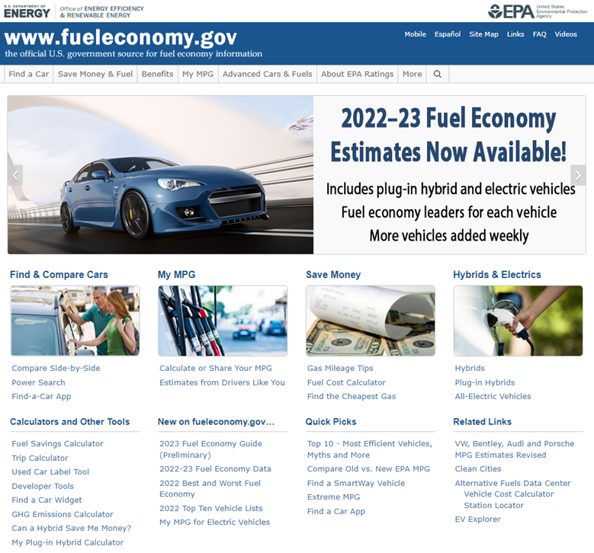
To look up the fuel economy of specific plug-in hybrid and all-electric vehicles, visit FuelEconomy.gov.

Slide 24
Thank you!

